Slide 1
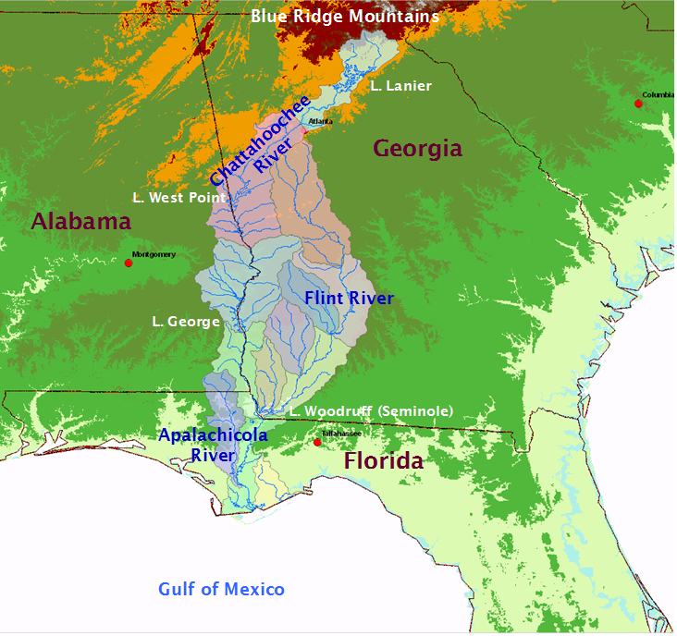
ACF Water Resources:
Managing Demand and Climate Change
Aris P. Georgakakos and Martin Kistenmacher
Georgia Water Resources Institute (GWRI), Georgia Tech
GPA 2012 Fall Conference, Columbus, GA, 26 September 2012
(Sponsored by NOAA, GA EPD, USGS, and ACFS)
Notes:
Title: 0 minutes

Slide 2
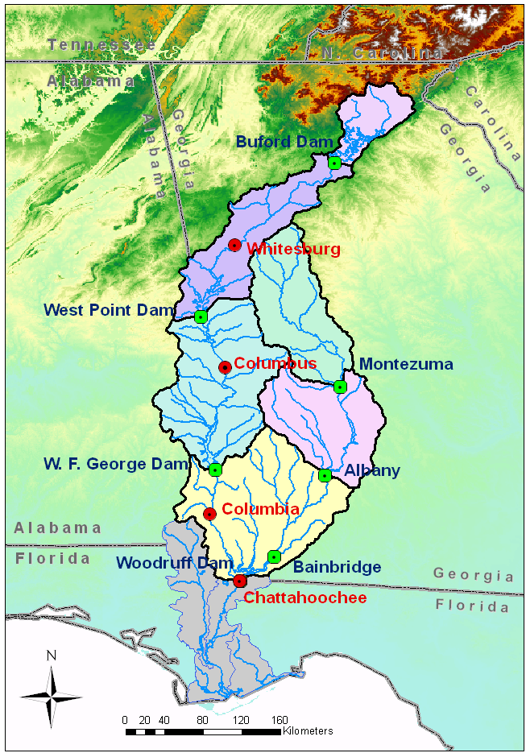
ACF River Basin: A Shared Resource
Main Nodes & Sub-basins
(Basin Area: 19,600 square miles)
Buford
1,040 sq. mi.
West Point
2,510 sq. mi.
Montezuma
2,920 sq. mi.
George
3,910 sq. mi.
Albany
2,390 sq. mi.
Woodruff-Bainbridge
4,430 sq. mi.
Apalachicola
2,500 sq. mi.
Cooling for 6 fossil fuel and 1 nuclear plants
Water Uses: Water Supply (Municipal, Industrial, Agricultural), Hydropower (10 hydro plants), Flood Control, Fisheries, Recreation, Navigation, Environment & Ecosystem Preservation.

Slide 3
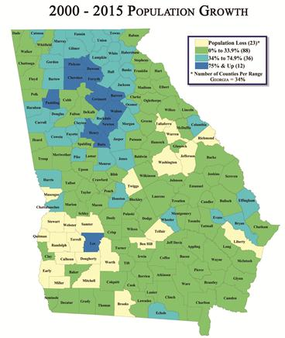
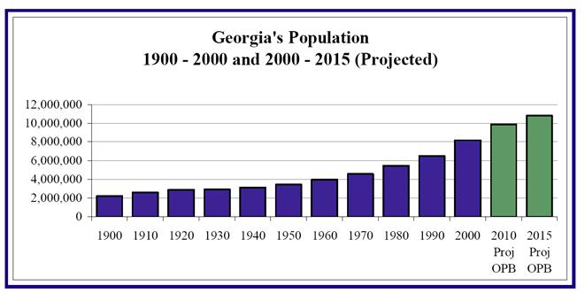
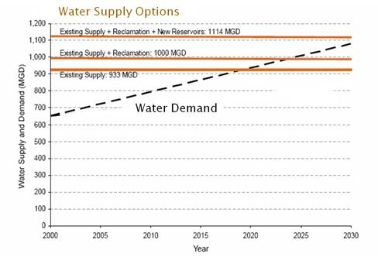
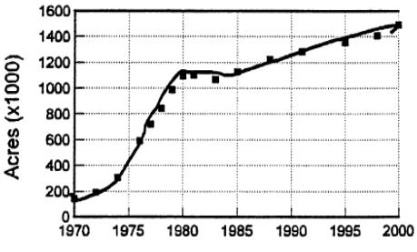
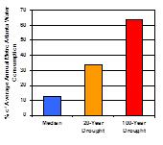
ACF: Changing Population, Land Use, and Water Demand
Population Increase
Irrigated Agriculture Growth
(South Georgia)
Atlanta Water Demand
2020: 1.01 bgd
2000: 0.60 bgd
1990: 0.46 bgd
100% Surface Water
40% Surface – 60% Groundwater

Slide 4
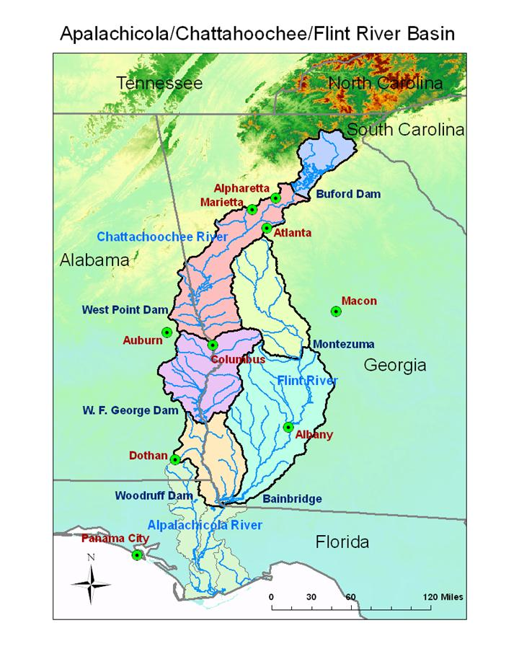
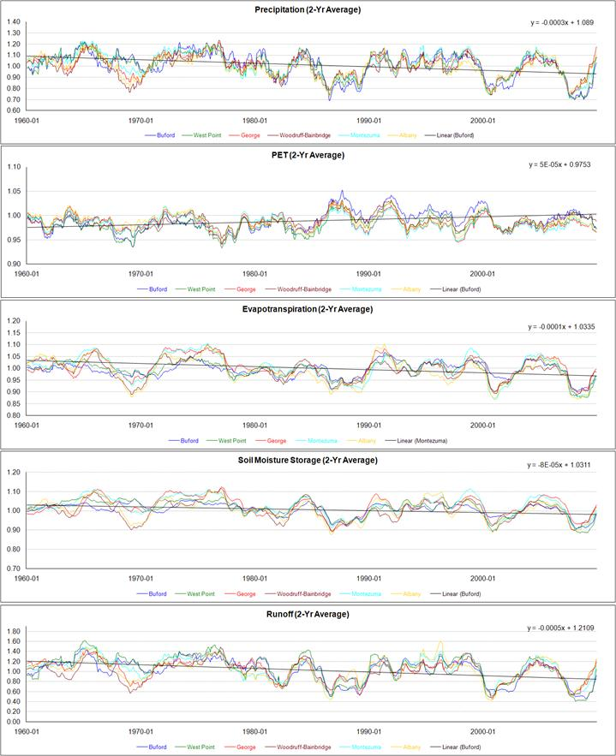
ACF: Changing Hydrology (1960 – 2009)
Key Findings
Precipitation:
Declining by 9% - 16% across the ACF watersheds (1960-2009);
PET:
Increasing by 1% - 3% across ACF (except for George where it decreases by about 0.8%);
Soil moisture:
Declining by about 3% - 6% across ACF;
Runoff:
Declining by about 16% - 27% across ACF.
Worst 2-Yr Drought
Figure 3.3: ACF Normalized, 2Yr Average Hydrologic Response (1960 - 2009).

Slide 5
Water Management Must Adapt to Change
Lake Management (Drought of 2007-2008)
The 2007-2008 drought was unprecedented, but its lake impacts were exacerbated by water management decisions.
Lake Lanier lost 50% of its storage capacity (18 feet) in six months.

Slide 6
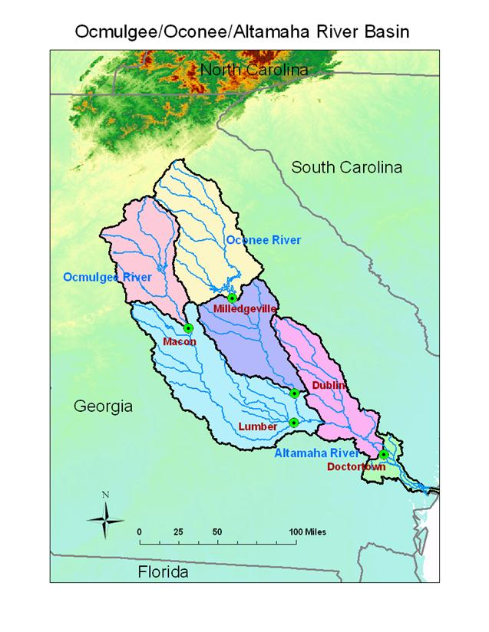
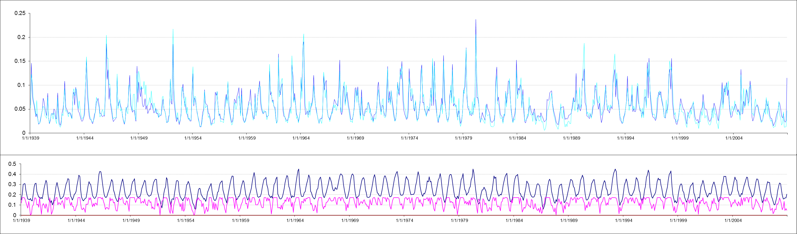
Hydrologic Modeling (GWRI Watershed Model)
Lake Lanier Watershed
Observed vs. Simulated UIFs

Slide 7
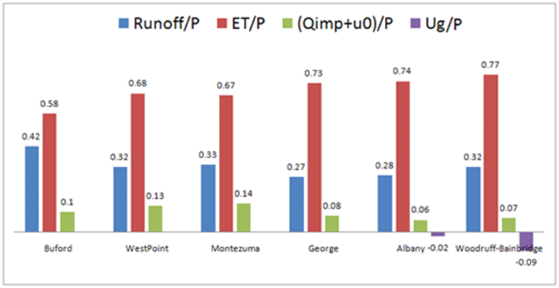
Historical Watershed Response – ACF Watersheds
Figure B-26: Average Hydrologic Response by Watershed (1901 - 2009) including Groundwater Recharge Flux Ug.

Slide 8
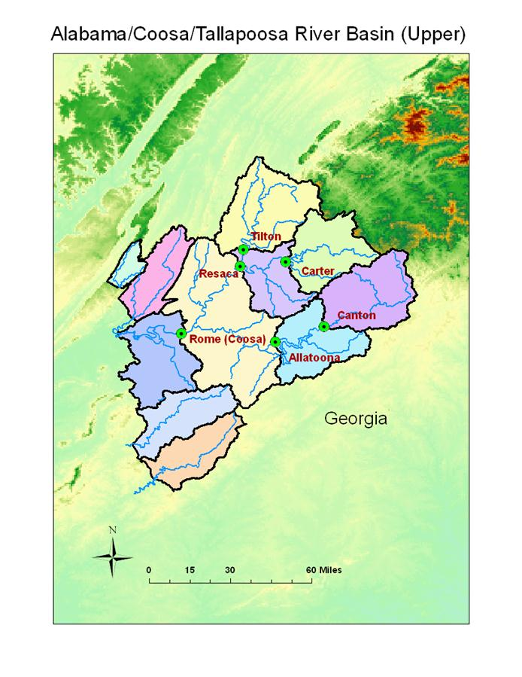
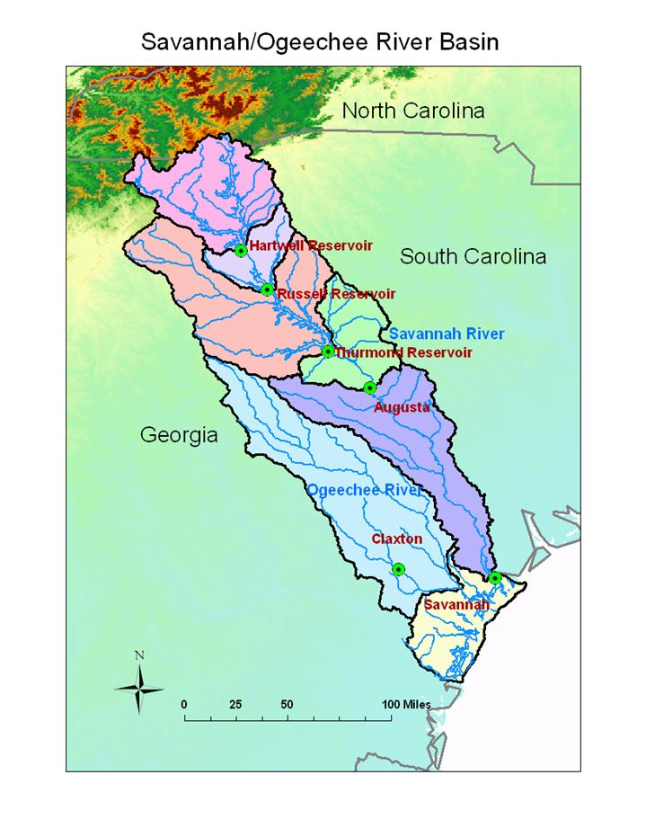
What about Other Georgia Basins?

Slide 9
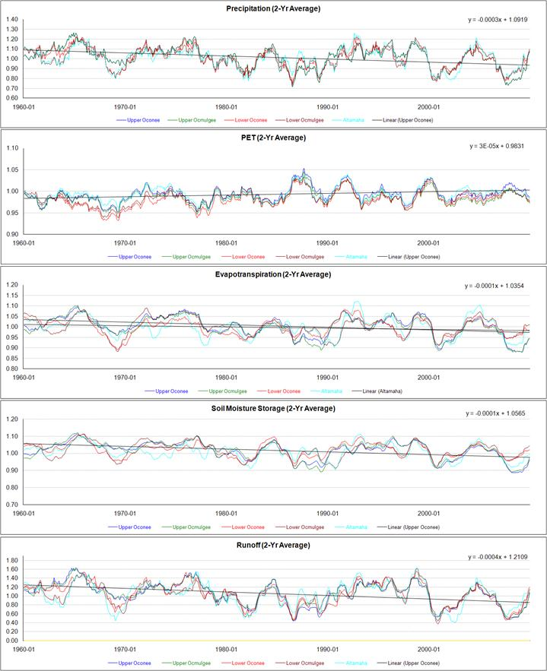
OOA: Changing Hydrology (1960 – 2009)
Key Findings
Precipitation:
Declining by 6% - 16% across the OOA watersheds (1960-2009);
PET:
Increasing by 1% - 3% across OOA;
Soil moisture:
Declining by about 3% - 6% across OOA;
Runoff:
Declining by 25% - 28% in upstream watersheds, and
by 5% - 20% downstream.
Figure 3.30: OOA Normalized, 2Yr Average Hydrologic Response (1960 - 2009).

Slide 10
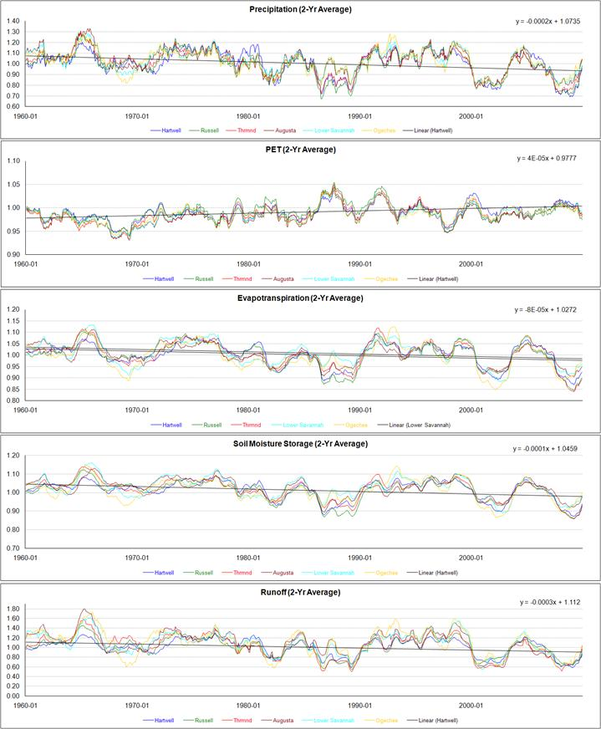
SO: Changing Hydrology (1960 – 2009)
Key Findings
Precipitation:
Declining by 10% - 18% across the SO watersheds (1960-2009), with steeper declines upstream;
PET:
Increasing by 2% - 3% across SO;
Soil moisture:
Declining by about 5% - 8% across SO;
Runoff:
Declining by 11% - 23%.
Figure 3.41: SO Normalized, 2Yr Average Hydrologic Response (1960 - 2009).

Slide 11

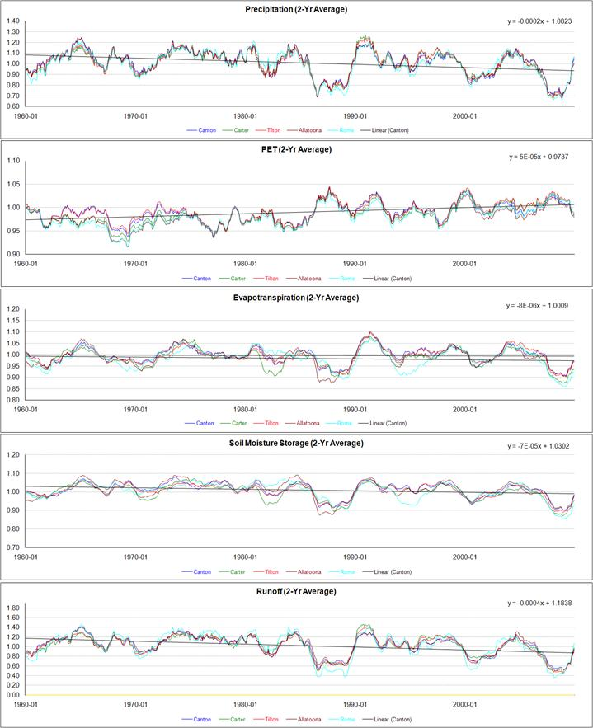
ACT: Changing Hydrology (1960 – 2009)
Key Findings
Precipitation:
Declining by 11% - 15% across the Upper ACT watersheds (1960-2009);
PET:
Increasing by 3% - 5% across ACT;
Soil moisture:
Declining by about 4% - 5% across ACT;
Runoff:
Declining by 20% - 23%.
Figure 3.52: ACT Normalized, 2Yr Average Hydrologic Response (1960 - 2009).

Slide 12
Historical Assessment Summary
In the last 50 years, all major Georgia basins (Upper ACT, ACF, OOA, and SO) exhibit:
Average precipitation declining trends;
PET rising trends;
Soil moisture declining trends;
Runoff declining trends;
Intensifying droughts.

Slide 13
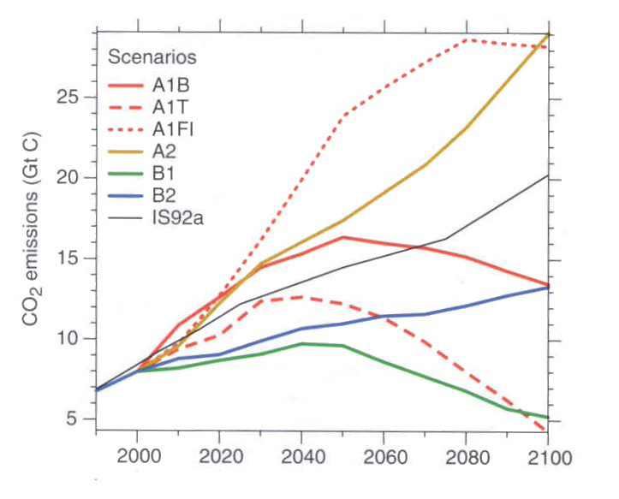
Projections for Future Values of Hydrologic Variables
Instead of assuming a stationary climate, future precipitation and temperature sequences are projected using Global Circulation Models (GCMs).
GCMs
Emission Scenarios
A2
A1B
13 GCMs x 2 Emission Scenarios
=
26 Future Climates

Slide 14
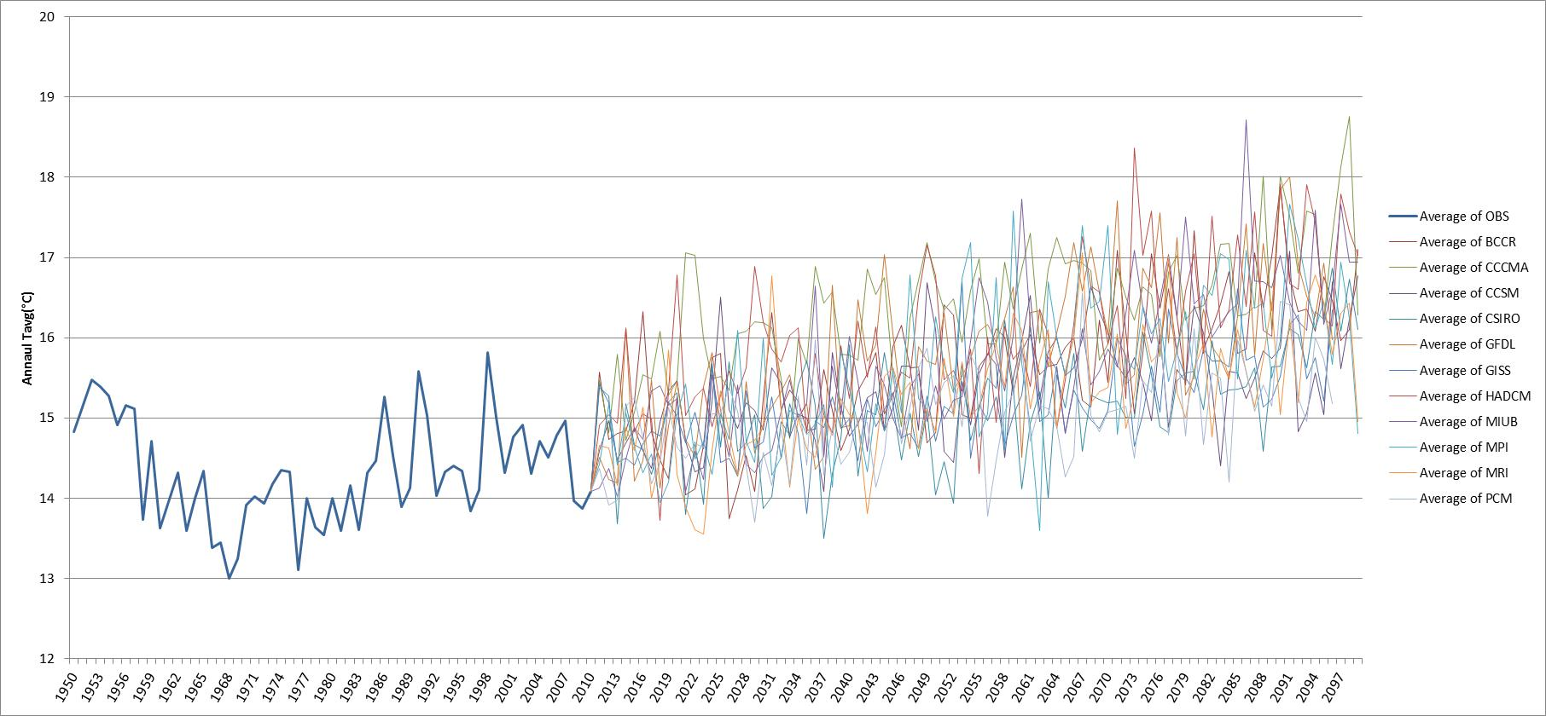
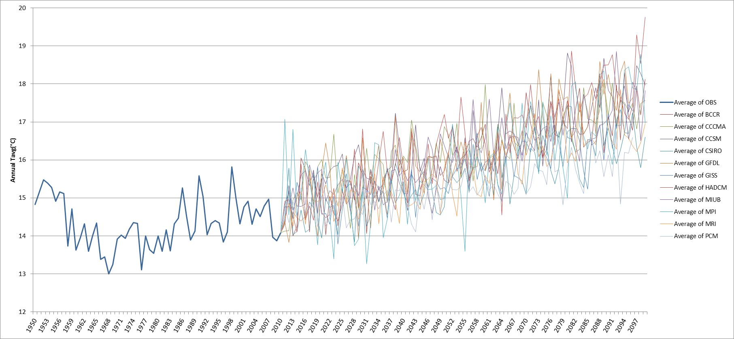
Annual Average Temperatures for Lake Lanier Watershed Historical Observations and Future Projections
A1B
A2
Warming Temperatures

Slide 15
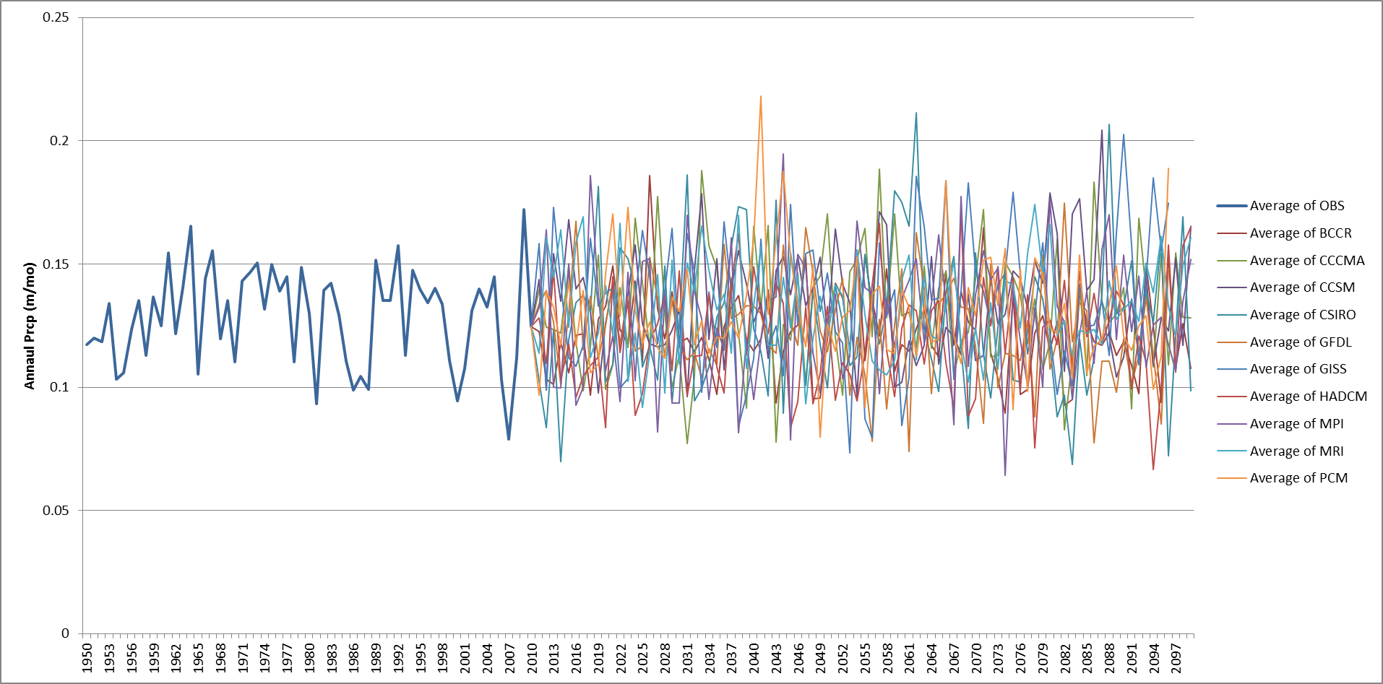
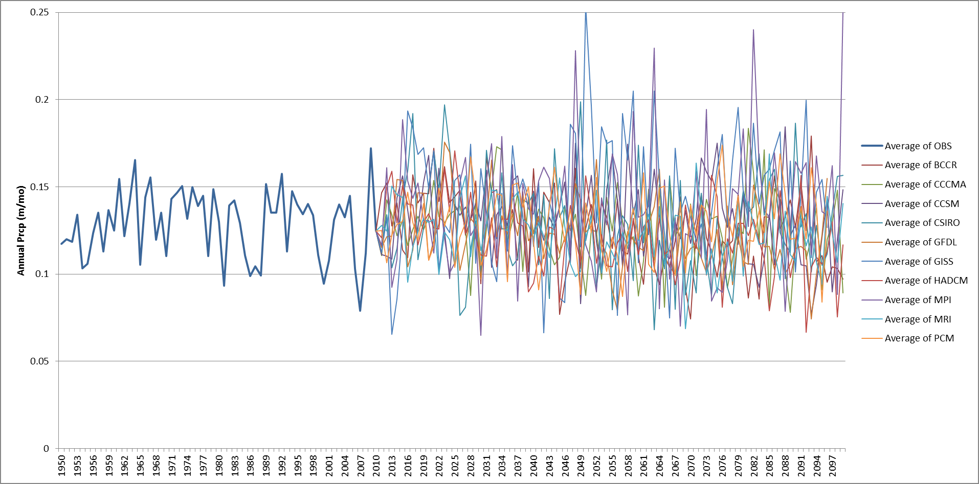
Annual Average Precipitation for Lake Lanier Watershed Historical Observations and Future Projections
A1B
A2
More Variable Precipitation

Slide 16
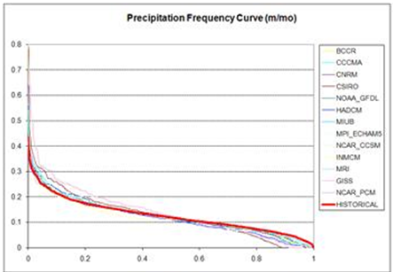
Future Climate Assessments – Lanier
The precipitation distribution is expected to “stretch” becoming wetter and drier than that of the historical climate. Namely, future floods and droughts will be more severe than those experienced in the historical past.
Precipitation (m/mo)
Probability of Exceedence

Slide 17
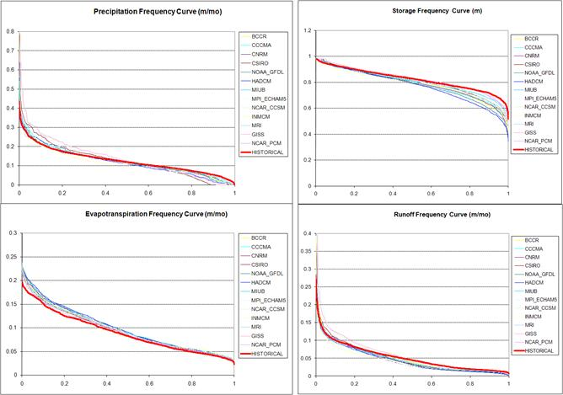
Future Climate Assessments – Lanier
Key Findings
The precipitation distribution is expected to “stretch” becoming wetter and drier than that of the historical climate. Namely, future floods and droughts will be more severe than those experienced in the historical past.
Lower soil moisture storage is expected, which may increase the amount of irrigation required for agriculture.
Figure 3.5: A2 Climate Scenarios (2000-2099), Buford, Frequency Curves.

Slide 18
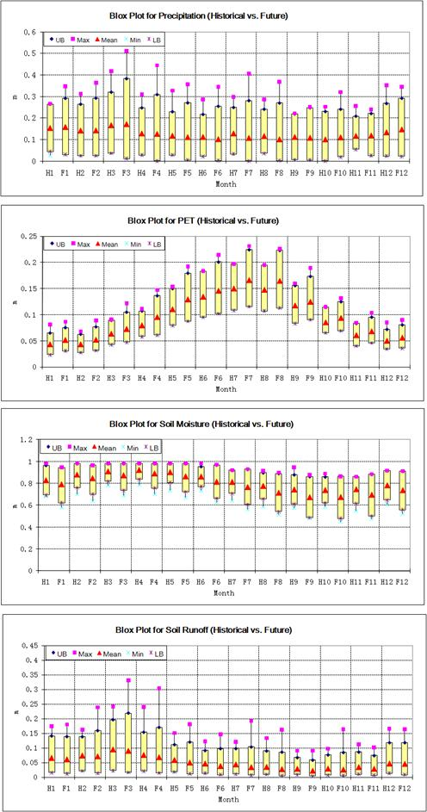
Future Climate Assessments – Lanier (Monthly)
Key Findings
Mean precipitation shows declining trends for June, July, and August.
Precipitation extremes for January - September are extended beyond the historical ranges.
(More severe floods and droughts.)
Future PET exhibits higher mean and wider range than historical PET from February to September, with the largest change observed in July and August (12% higher than historical).
Future soil moisture is clearly lower than historical in almost all months, especially in late summer and fall (exhibiting a 6% - 10% declining trend).
Future mean runoff is drier that historical in all months of the year (A2 scenarios), and with a wider range.
Figure 3.7: Monthly Historical vs. Future (A2) Watershed Response, Buford. (P – m/mo; PET – m/mo; Soil Moisture – m; Runoff m/mo.)

Slide 19
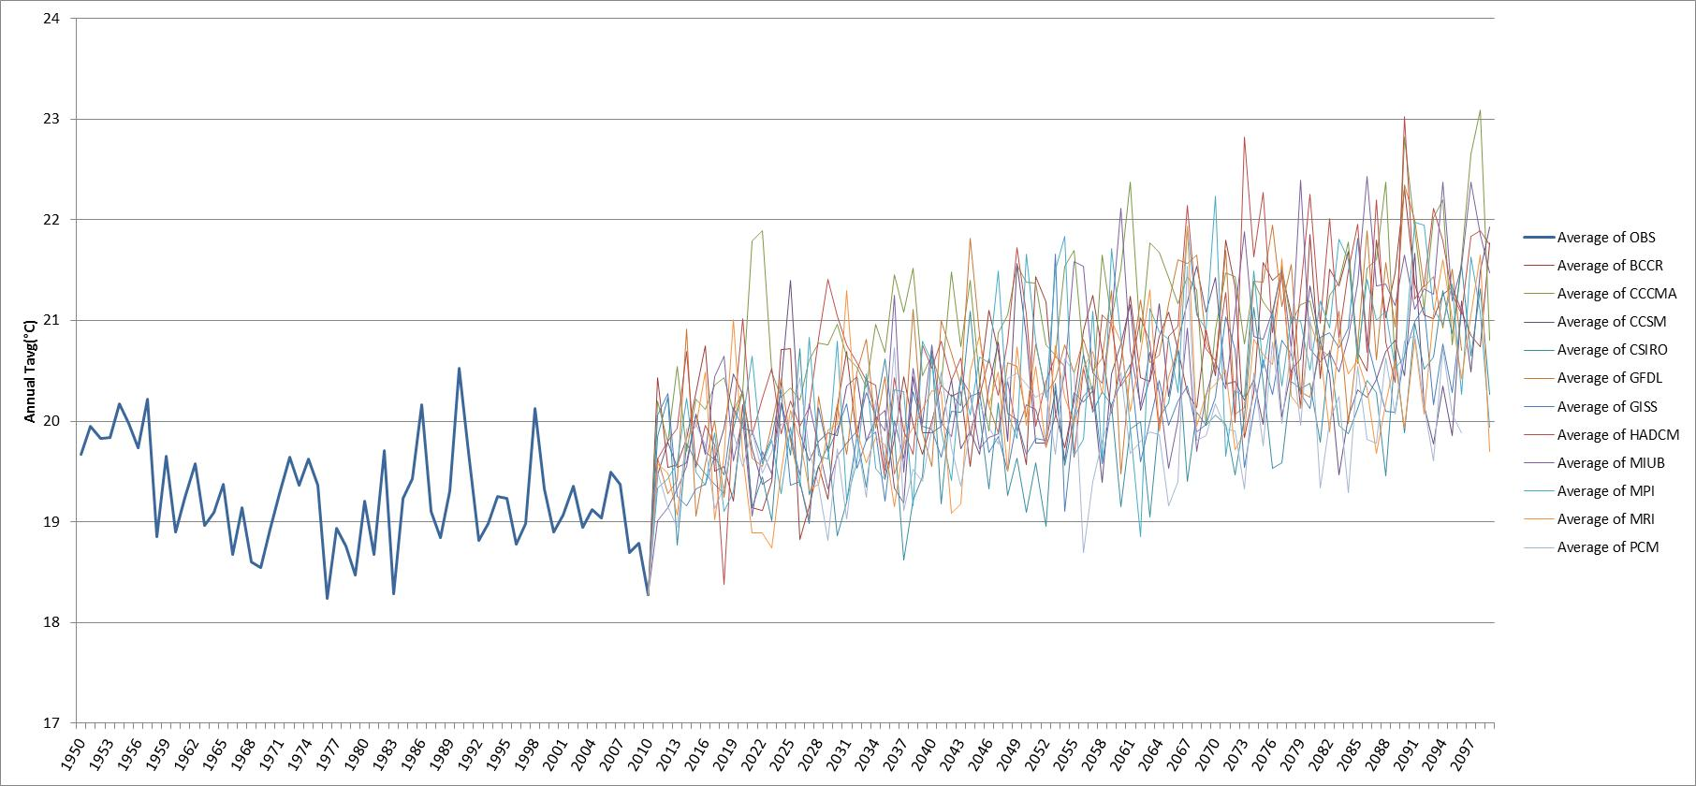
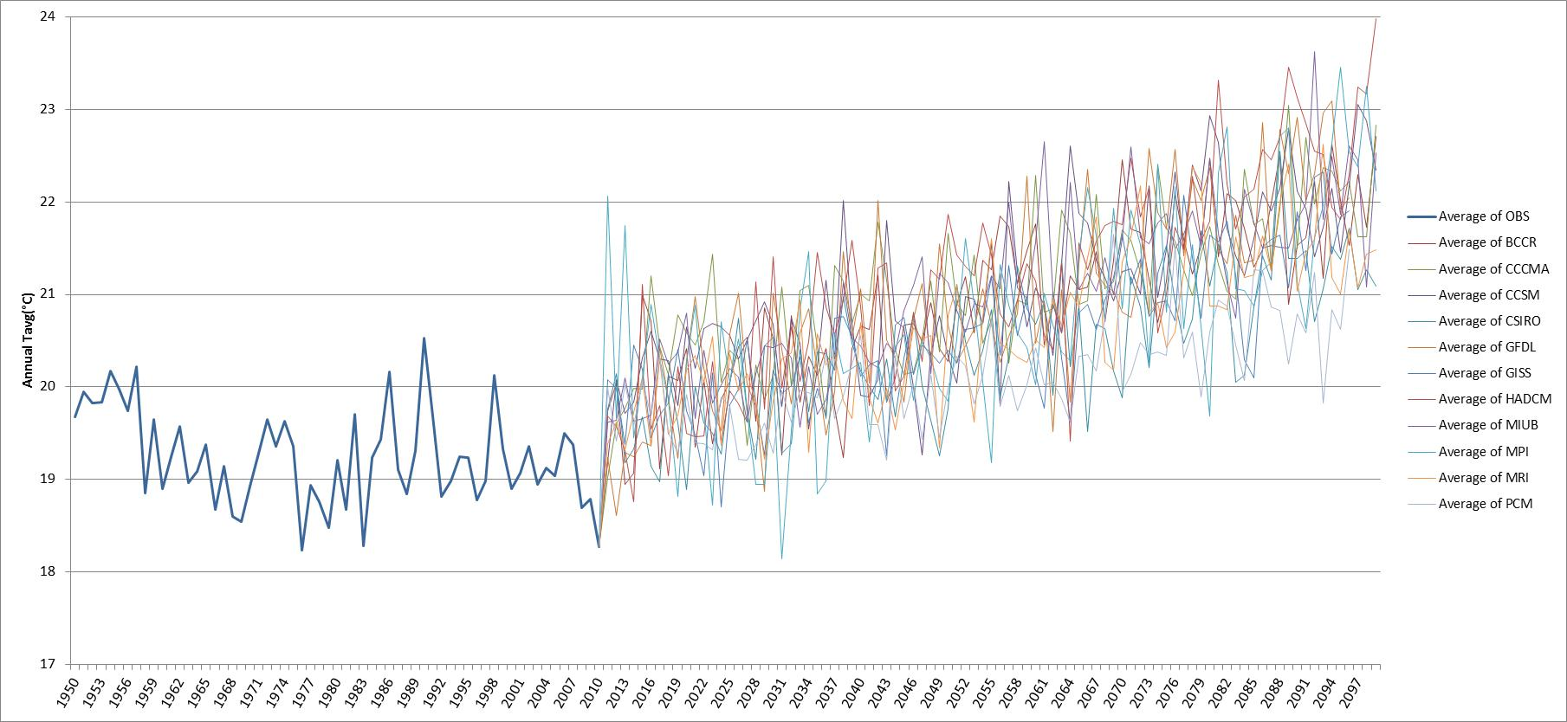
Annual Average Temperatures for Lake Seminole Watershed Historical Observations and Future Projections
A1B
A2
Warming Temperatures

Slide 20
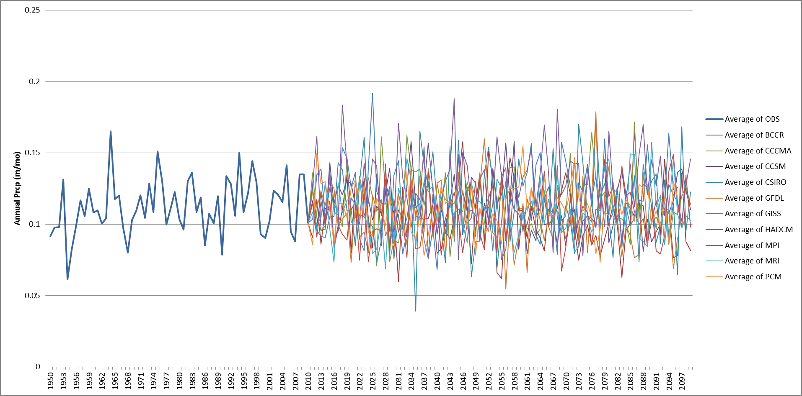
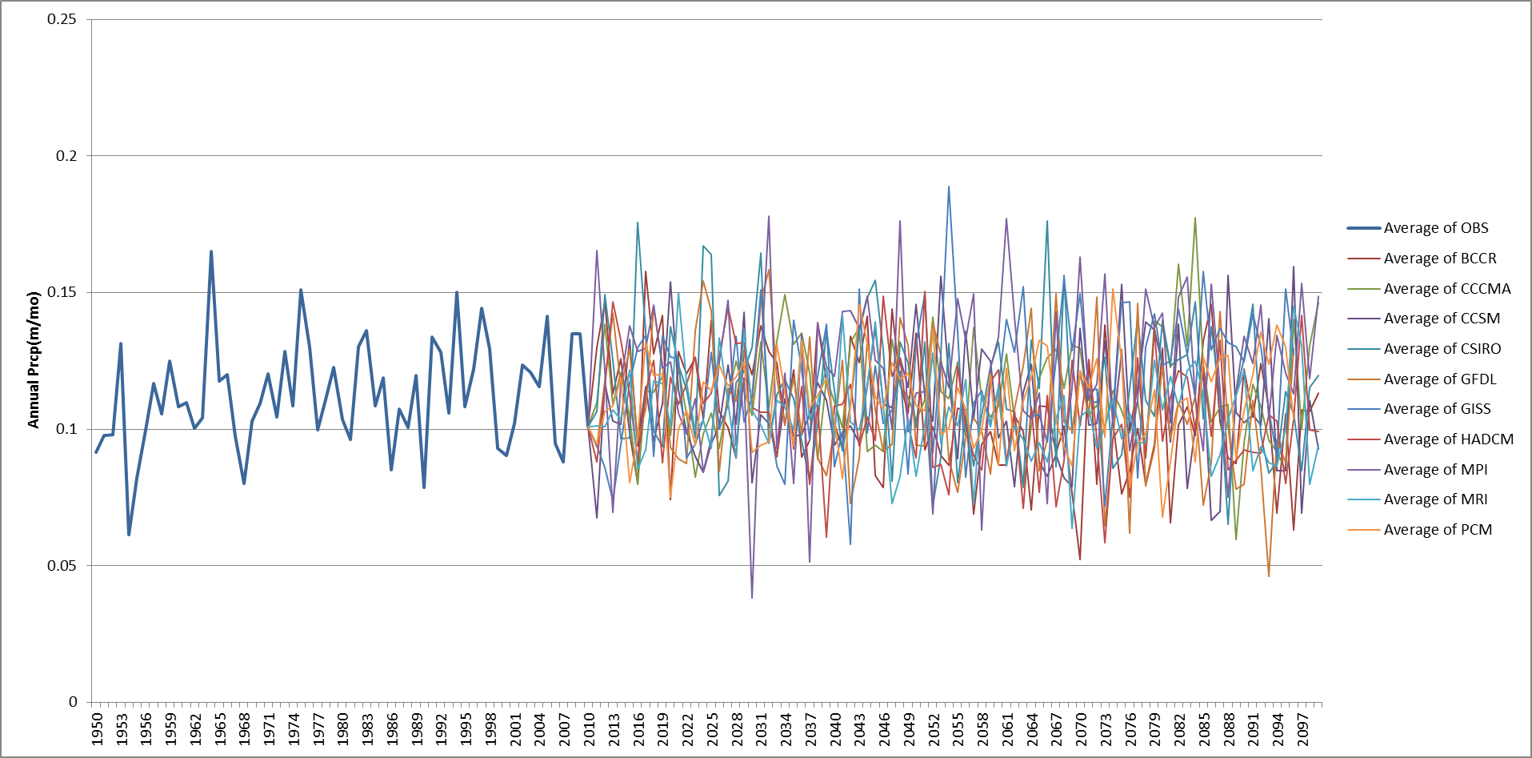
Annual Average Precipitation for Lake Seminole Watershed Historical Observations and Future Projections (A1B Emission Scenarios)
A1B
A2
More Variable Precipitation

Slide 21
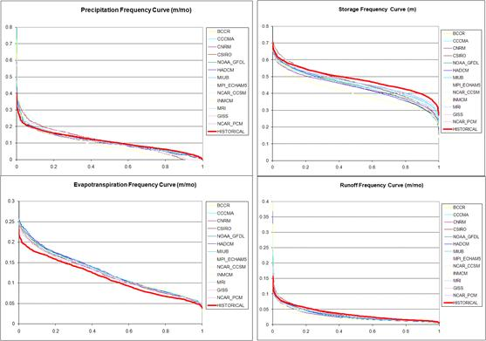
Future Climate Assessments – Seminole (Annual)
Key Findings
Average precipitation is expected to follow historical trends.
The precipitation distribution is expected to “stretch” becoming wetter and drier than the historical climate.
All future scenarios portend higher PET, higher ET, and lower soil moisture storage. This effect is especially pronounced in dry years (falling below 75% of the distribution values).
In the 8% wettest years, runoff is expected to be higher than historical. However, the rest of the future distributions indicate drier than historical runoff conditions.
Namely, future floods and droughts will be more severe than those experienced in the historical past.
Figure 3.25: A2 Climate Scenarios (2000-2099), Woodruff-Bainbridge, Frequency Curves.

Slide 22
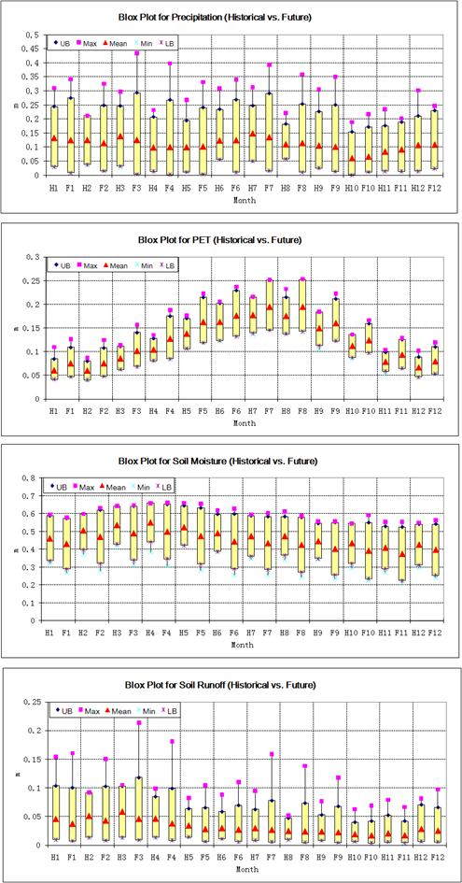
Future Climate Assessments – Seminole (Monthly)
Key Findings
Mean precipitation exhibits decreasing trends in early spring (January, February, and March) and summer (June, July, and August) of about 9%.
Precipitation extremes are especially extended from January to September. (More severe floods and droughts.)
Future PET exhibits higher mean and wider range than historical PET with the largest change observed in July and August (up to 15%).
Future soil moisture is lower than historical in most months. This change is more pronounced for summer and fall, and it is larger than in Buford. Summer months are particularly impacted, with critical implications for agriculture.
Mean runoff declines, and exhibits a wider range than historical.
Figure 3.27: Monthly Historical vs. Future (A2) Watershed Response, Woodruff-Bainbridge. (P – m/mo; PET – m/mo; Soil Moisture – m; Runoff m/mo.)

Slide 23
Future Climate Assessment Summary
ACF watersheds are expected to experience reduced mean precipitation with wetter and dryer extremes;
All watersheds show significant PET increases, especially in summer;
Soil moisture is expected to decrease in most months and especially in summer; (Critical implications for agriculture);
Mean runoff is expected to decrease in most months, especially in summer, and will be more variable. (Critical implications for water management.)

Slide 24
Implications for Water Resources Planning
ACF watersheds are expected to experience reduced mean precipitation with wetter and dryer extremes;
All watersheds show significant PET increases, especially in summer;
Soil moisture is expected to decrease in most months and especially in summer; (Critical implications for agriculture);
Mean runoff is expected to decrease in most months, especially in summer, and will be more variable. (Critical implications for water management.)

Slide 25
ACF Water Resources Assessments
Water Demand Scenarios 2007 and 2050
Future Agricultural Water Demand Projections Do Not Account for Climate Change.

Slide 26
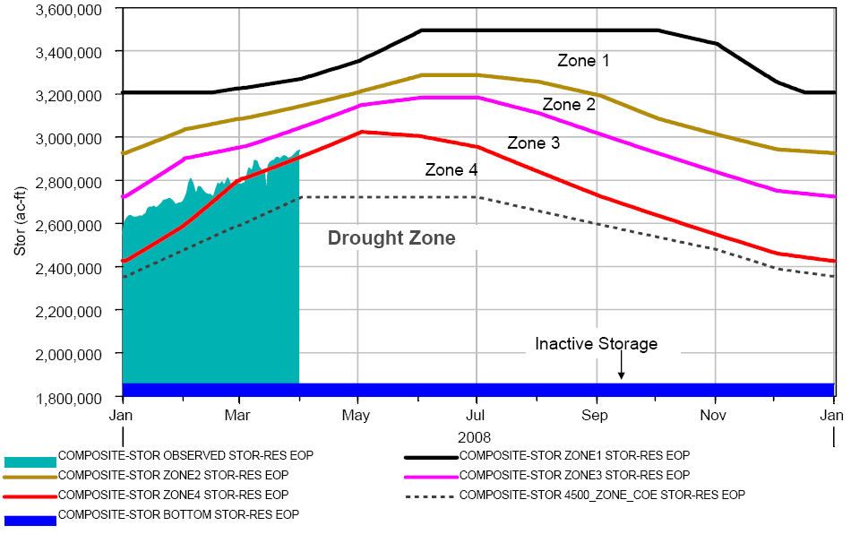
Woodruff Release Requirements—Revised Interim Operations Plan (RIOP)
Composite Storage Zones
Woodruff Release Limits

Slide 27
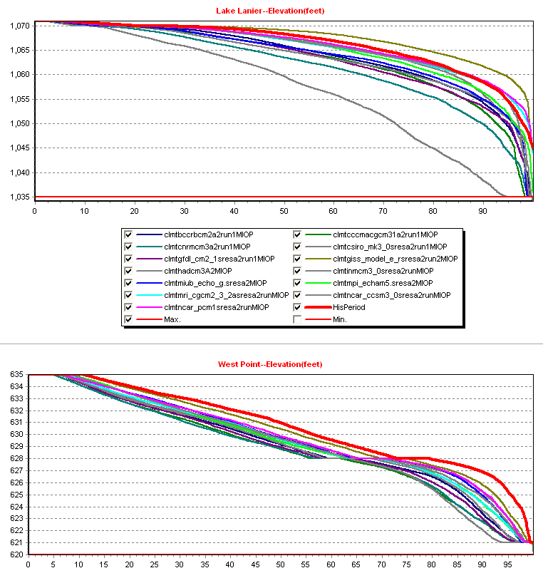
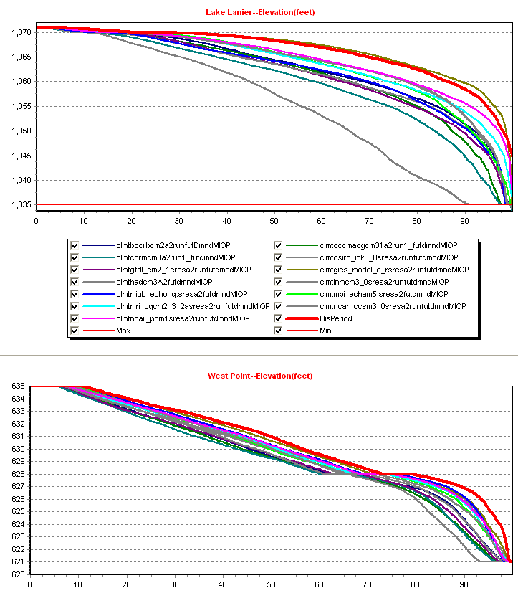
Lake Level Assessment
A2 – 2007 Dmnds
A2 – 2050 Dmnds
Key Messages
Future A2 climates portend deeper and more frequent lake drawdowns.
2050 Demands exacerbate lake water stress.

Slide 28
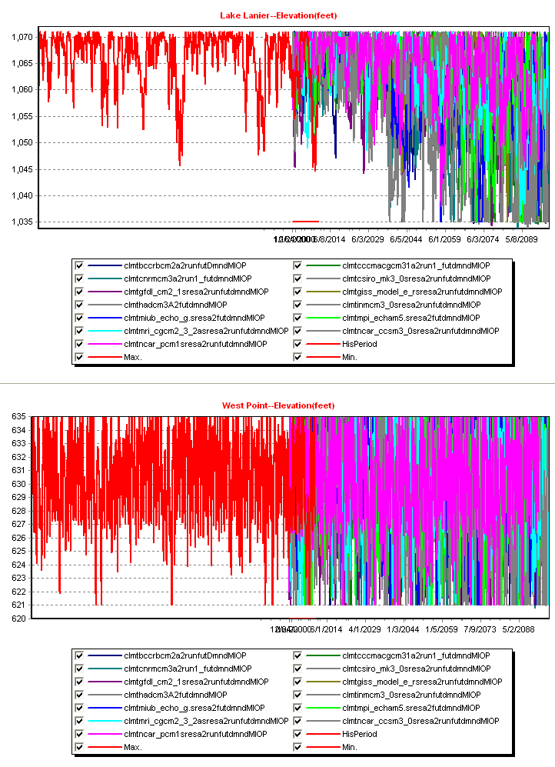
Lake Lanier Level Sequences
Historical and Future Climates (A2) and 2050 Demands
Key Messages
Drawdowns intensify beyond 2050.

Slide 29
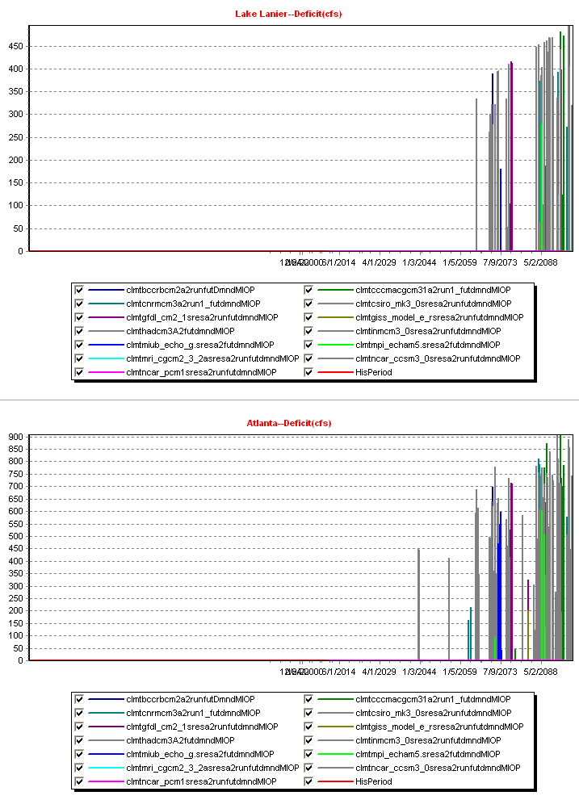
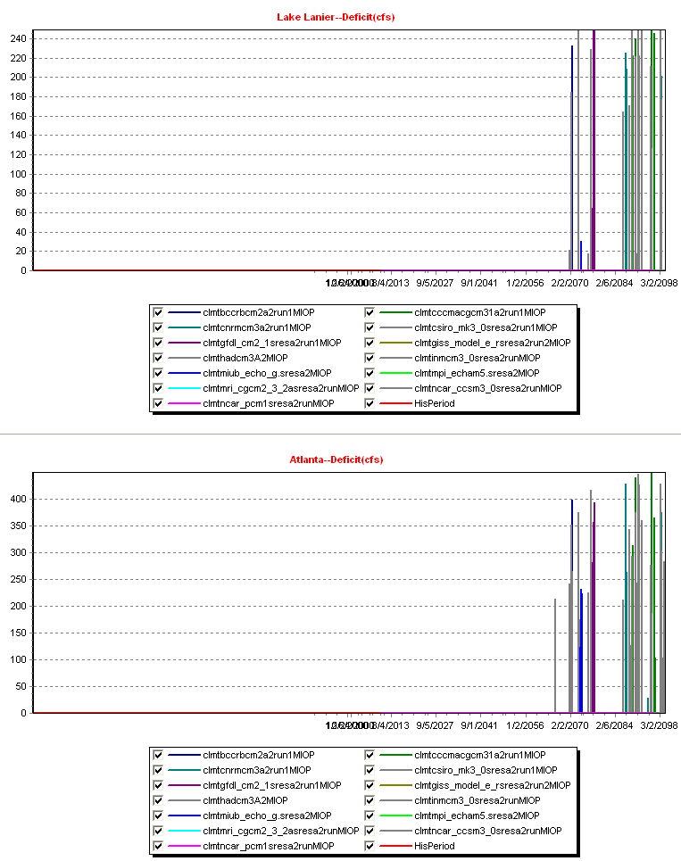
Water Supply Deficit Assessments—Atlanta
A2 – 2007 Dmnds
A2 – 2050 Dmnds
Key Messages
Future A2 climates indicate that Atlanta will be vulnerable to critical water supply deficits beyond 2060.

Slide 30
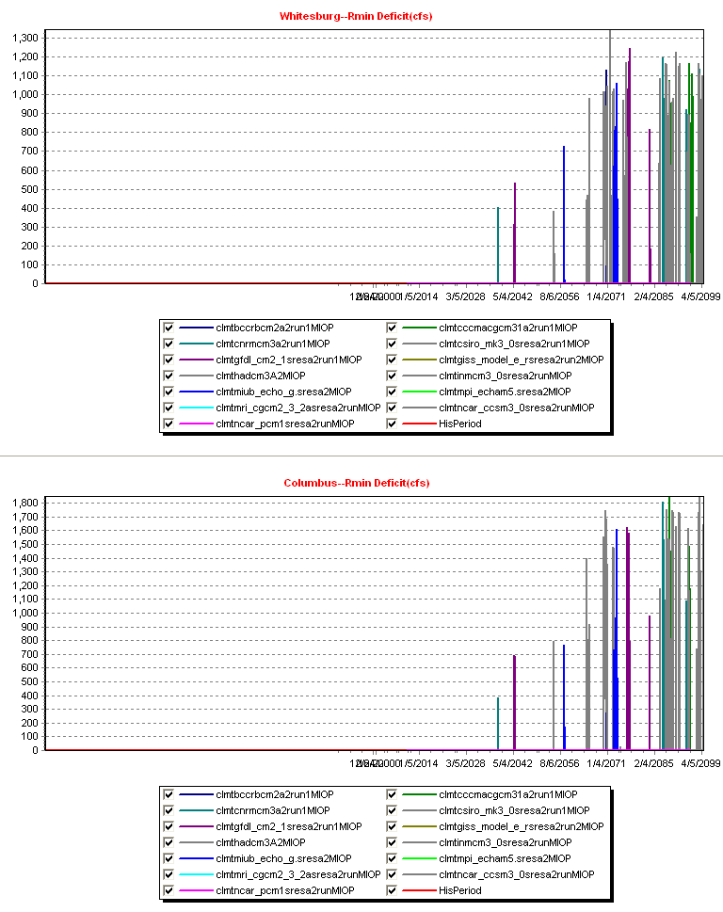
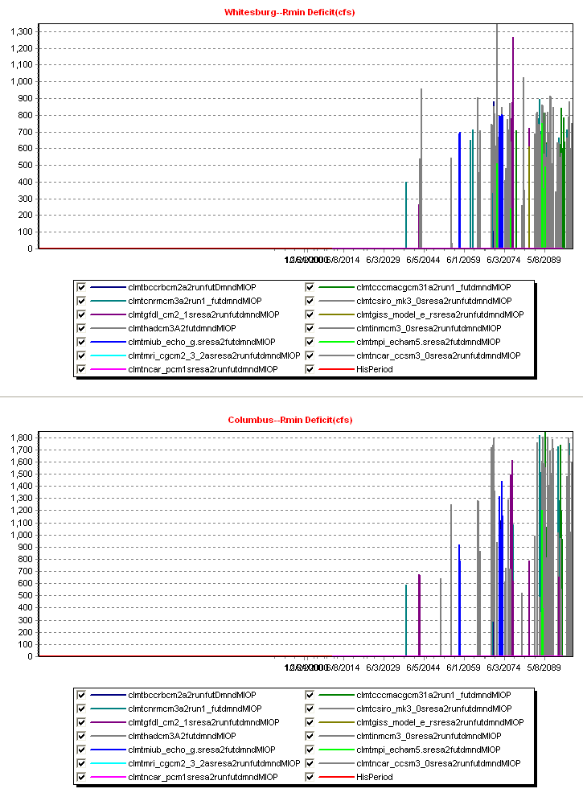
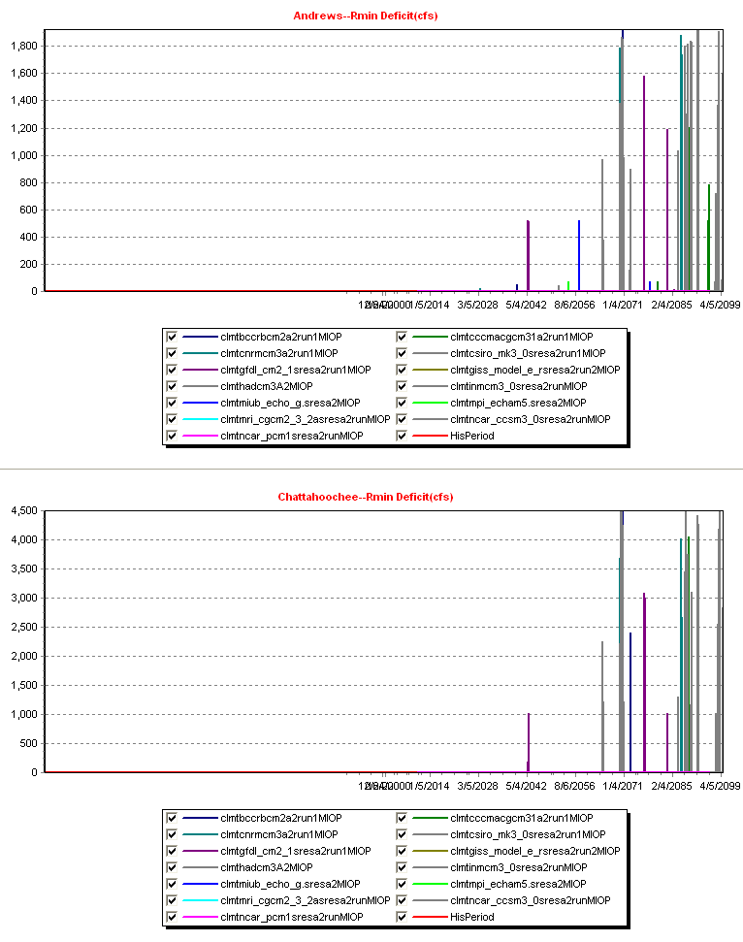
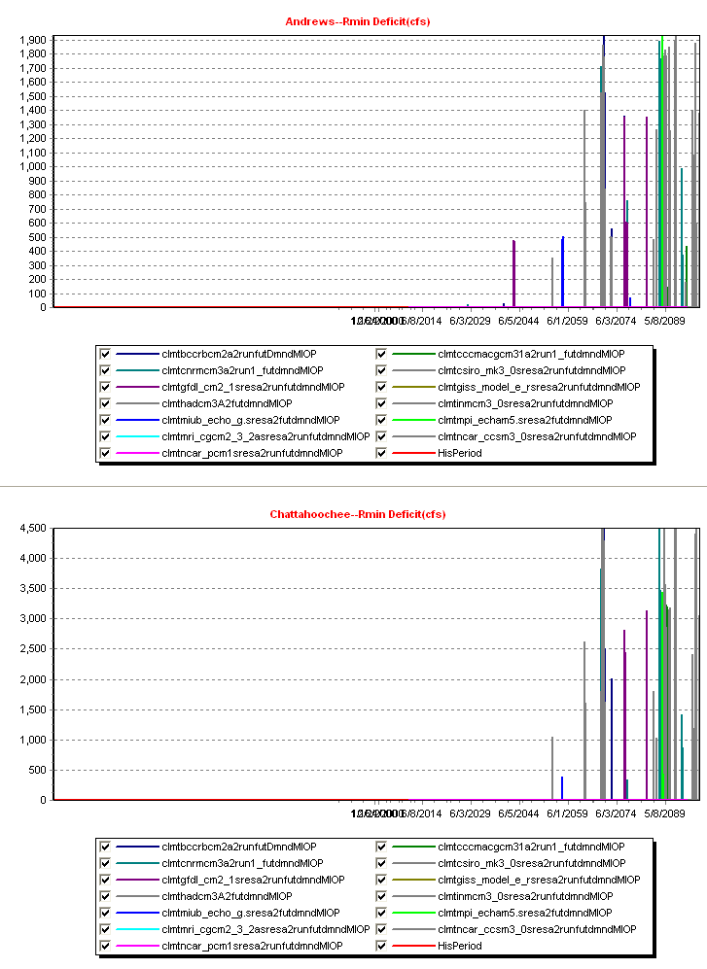
In-stream Flow Target Deficit Assessment
A2 – 2007 Dmnds
A2 – 2050 Dmnds
Whitesburg
Whitesburg
Columbus
Columbus
Chattahoochee
Chattahoochee
Key Messages
Future A2 climates are likely to impair ACF’s capacity to meet in-stream flow targets, especially beyond 2060 and under increased demands.

Slide 31
Water Resources Assessment Summary
Lessons to be Thought about
ACF will become increasingly vulnerable to climate change and variability, especially beyond 2050-2060.
Water policies and regulation procedures based on historical stream flows and water levels cannot effectively respond to a changing and more variable climate. More flexible and adaptive approaches are needed to mitigate risks.
Water planning must be integrated and begin to consider appropriate adaptation strategies (in conservation, infrastructure, and management).

Slide 32
Water Resources Assessment Summary
Lessons to be Thought about
ACF will become increasingly vulnerable to climate change and variability, especially beyond 2050-2060.
Water policies and regulation procedures based on historical stream flows and water levels cannot effectively respond to a changing and more variable climate. More flexible and adaptive approaches are needed to mitigate risks.
Water planning must be integrated and begin to consider appropriate adaptation strategies (in conservation, infrastructure, and management).
Opportunities
State Water Plan is a very good start, but it should become a sustained process, not a one-time plan.
Are we willing to invest in our future?
ACFS is an unprecedented and promising stakeholder engagement paradigm.
Modern Decision Support Tools can support IWRM.
Are our institutions willing to embrace them?

Slide 33
Integrated Water Resources Assessment/Planning Framework
Climate-Hydrology-Water Resources-Environment-Energy…
Climate - Sea Level Rise Scenarios & Downscaling (Historical, Future)
Land Use/Cover
Scenarios
Demographic &
Socio-Economic
Scenarios
Rainfall, temperature, PET,
etc., sequences.
Hydrologic Response
Surface/Ground/WQ
Sectoral Demand Targets, Metrics
WS (urbn/ag/ind), Enrgy, Fisheries, Nav, Env.…
Mgt./Adapt. Options
Soil moisture, ET, runoff,
aquifer recharge, WQ, etc.
River-Reservoir-Aquifer-Estuary Response
Actual water use levels,
recreation, hydro-thermal enrgy,
env. flows, lake/aquifer levels,
fisheries, …
Environ. - Socioeconomic
Impact Assessments
Risks/Vulnerabilities/Tradeoffs
(by sector and region)
Stakeholder Processes
Consensus Building
Shared Vision Mgt. Policies, Adaptation Measures, Indicators

Slide 34
Preliminary Stakeholder Performance Criteria
Modeling Goal: Represent all water use targets and performance criteria in a manner agreed upon by all stakeholders.

Slide 35
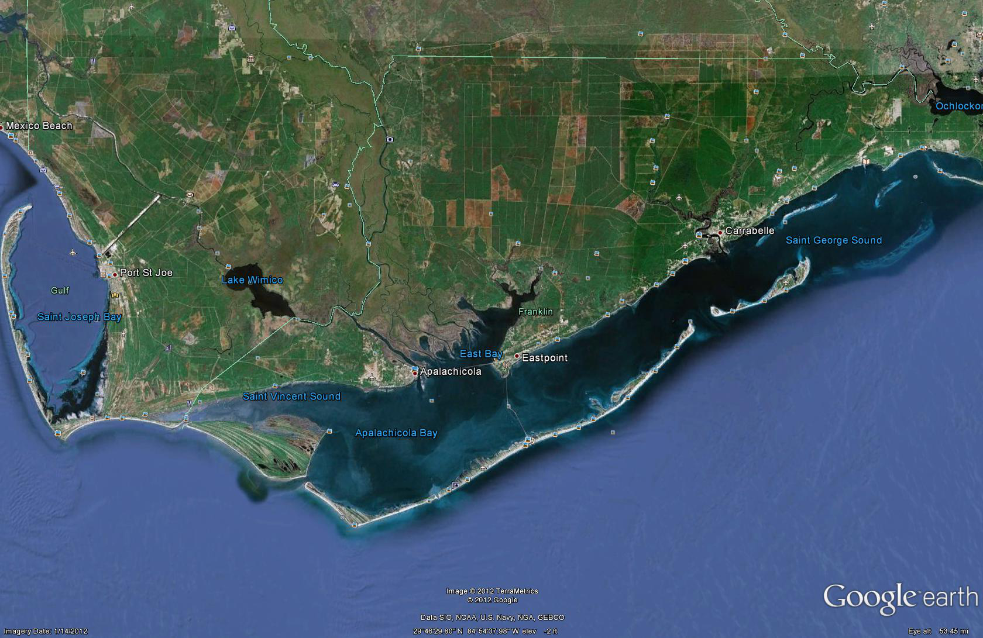
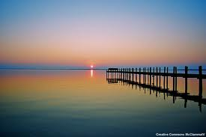
Apalachicola Bay: Hydrodynamic and Salinity Model
A. Georgakakos, P. Roberts, B. Villegas, H. Yao, M. Kistenmacher
Georgia Water Resources Institute (GWRI), Georgia Tech
GPA 2012 Fall Conference, Columbus, GA, 26 September 2012
Sponsored by GWRI
Apalachicola Hydrodynamic Salinity Model
Model Calibration and Validation
Model Results for 2008, 2009, and 2010
Possible Way Forward
Notes:
Title: 0 minutes

Slide 36
Apalachicola Bay: Hydrodynamic and Salinity Model
A. Georgakakos, P. Roberts, B. Villegas, H. Yao, M. Kistenmacher
Georgia Water Resources Institute (GWRI), Georgia Tech
GPA 2012 Fall Conference, Columbus, GA, 26 September 2012
Sponsored by GWRI
Notes:
Title: 0 minutes

Slide 37
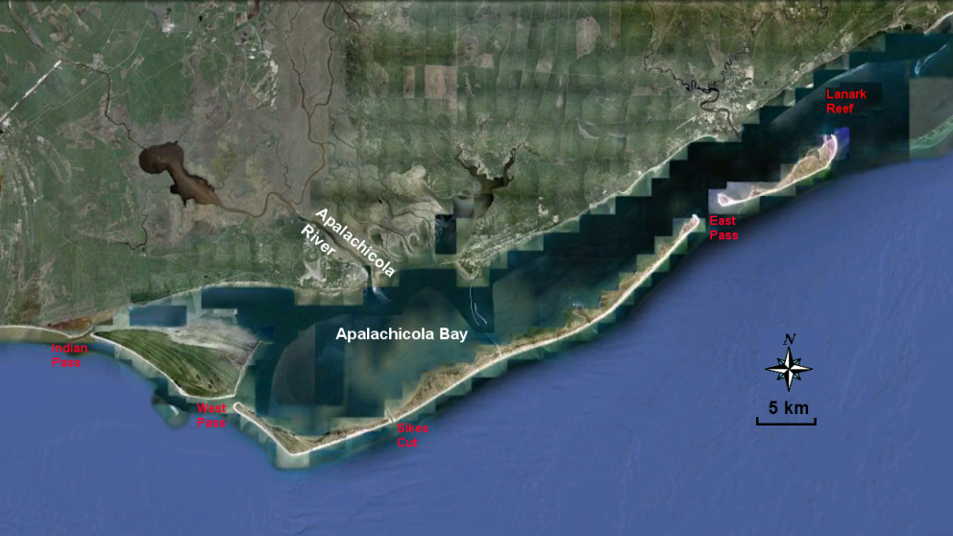
ACF Integrated Modeling and Assessments
Apalachicola Bay
Length: 65 km; Width: 5.5 to 12 km; Depth: 6 m (ocean side) to 3 m (river mouth)
Freshwater inflow: Apalachicola (90%), Whiskey George/Cash Creek, Carrabelle
Importance: Rich ecosystem; 131 freshwater & estuarine fish species; Nursery for many important Gulf species; 90% Oyster production in Florida and 10% in nation.

Slide 38
ACF Integrated Modeling and Assessments
Apalachicola Bay
Length: 65 km; Width: 5.5 to 12 km; Depth: 6 m (ocean side) to 3 m (river mouth)
Five inlets: Indian Pass, West Pass, East Pass, Sikes Cut, and Lanark Reef
Freshwater inflow: Apalachicola (90%), Whiskey George/Cash Creek, Carrabelle
Flow Rate: 400 – 4,000 m³/s
Importance: Rich ecosystem; 131 freshwater & estuarine fish species; Nursery for many important Gulf species; 90% Oyster production in Florida and 10% in nation.

Slide 39
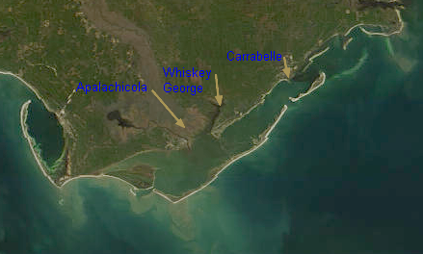
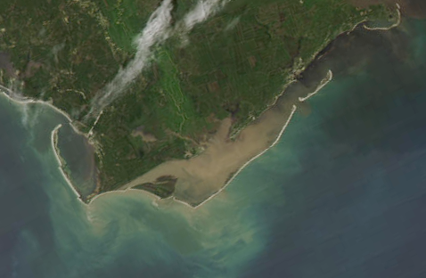
Seasonal Satellite Images
Terra/MODIS: January 7th 2011 - Winter
Aqua/MODIS: April 6th 2009 - Spring

Slide 40
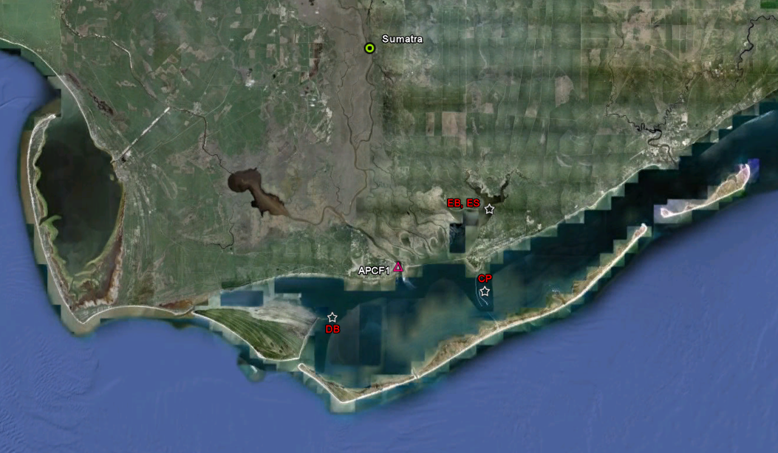
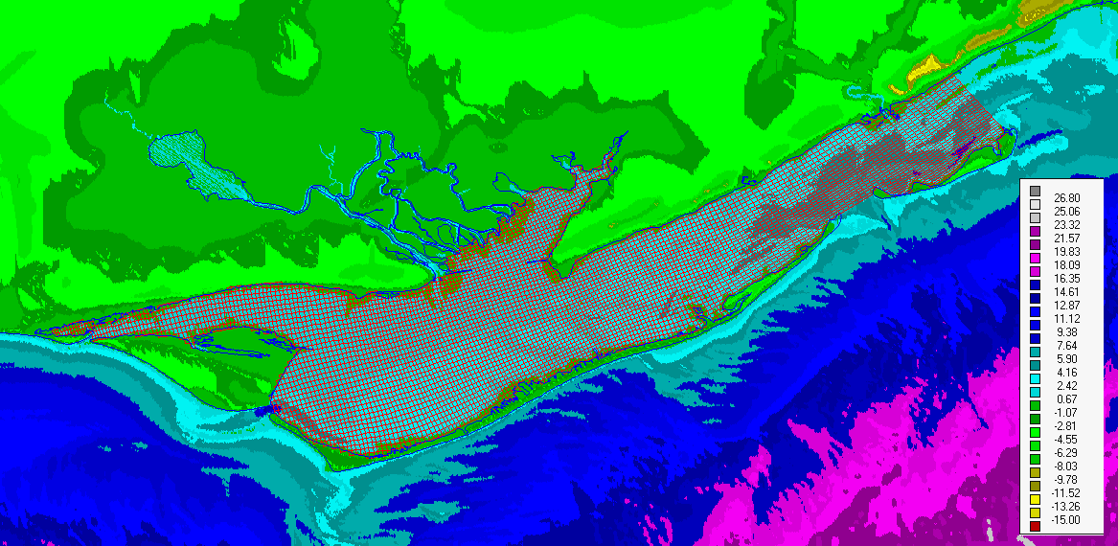
Hydrodynamic and Salinity Model
Model (Delft3D): Calibrated (2008); Validated (2009-2010); Run (1996-2010).
Recording Station Locations
Bathymetry – Model Grid
200 x 200 m (near river mouth) -- 600 x 600 m
5 vertical layers
Data Used:
Bathymetry: NOAA National Geophysical Data Center US Coastal Relief Model
Water Level: NOAA Apalachicola station (6-min);
River Discharge: USGS Sumatra (daily);
Winds: NOAA meteorological station APXF1 (6-min);
Salinity: Apalachicola National Estuarine Research Reserve (ANERR)
CatPoint (CP); DryBar (DB), and EastBay (EB)
Driving Forces: Diurnal and semi-diurnal tides 0.2 – 0.6 m; Wind; River discharge
Residence Time: ~ 5 – 9 days

Slide 41
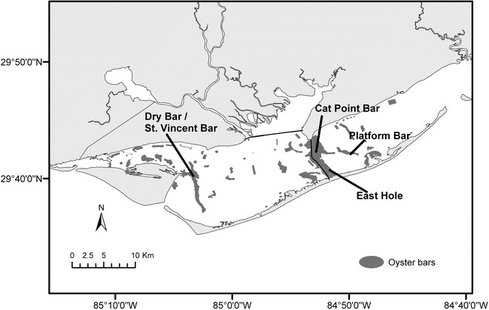
Optimal Oyster Salinity Range
10 < Salinity < 26 ppt
Oyster bars

Slide 42
River Discharge and Wind Data
Apalachicola Daily Discharge (Sumatra)
Predominantly:
NE Direction
Average Monthly Wind Speeds
Month | 2008 | 2009 | 2010
January | 3.64 | 2.90 | 3.38
February | 2.80 | 2.90 | 3.10
March | 3.59 | 3.33 | 3.03
April | 3.11 | 3.52 | 3.37
May | 3.08 | 3.70 | 3.27
June | 2.16 | 2.44 | 2.56
July | 2.14 | 2.28 | 3.09
August | 2.86 | 2.45 | 3.00
September | 3.55 | 3.10 | 3.00
October | 3.91 | 2.77 | 2.85
November | 3.06 | 3.49 | 3.04
December | 2.88 | 3.41 | 2.32
Avg - 3 m/s; Max – 14.3 m/s (10/24/2008)

Slide 43
Model Calibration – Water Level
(Measured vs. Simulated Values; April 1 – June 1, 2008)
Variance Explained > 90%
Instrument Miscalibration

Slide 44
Model Calibration – Salinity
(Measured vs. Simulated Values; April 1 – June 1, 2008)
Variance Explained > 80%
Likely Measurement Error

Slide 45
Model Validation – Water Level
(Measured vs. Simulated Values; Sep 1 – Nov 1, 2009)
Instrument Miscalibration

Slide 46
Model Validation – Salinity
(Measured vs. Simulated Values; Sep 1 – Nov 1, 2009)

Slide 47
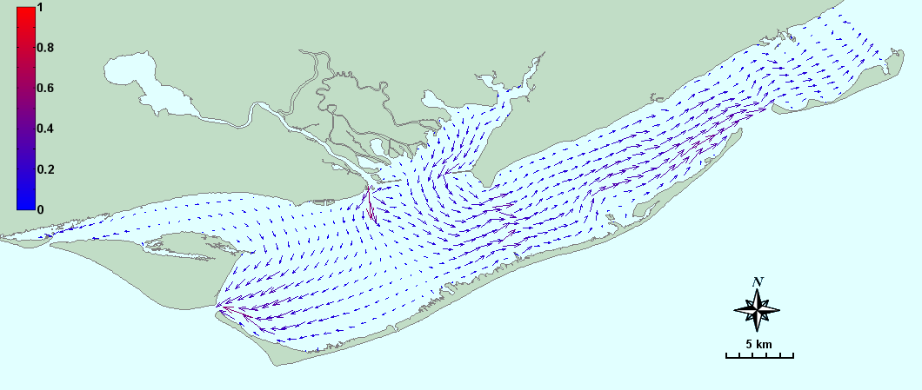
Model Results – Velocities
Typical Depth Average Velocity Distribution
Vertical Profiles

Slide 48



Model Results – Salinity Distributions
Surface Contours - May 1, 2008
Vertical Profiles
Vertical Stratification

Slide 49







Model Results – Monthly Averages
January
February

Slide 50






Model Results – Monthly Averages
March
April

Slide 51






Model Results – Monthly Averages
May
June

Slide 52





Model Results – Monthly Averages
July
August

Slide 53






Model Results – Monthly Averages
September
October

Slide 54






Model Results – Monthly Averages
November
December

Slide 55




Model Results – Monthly Variability
December Average
December St. Dev.

Slide 56






Model Results – Monthly Max and Min Values
December Maxima
December Minima

Slide 57
Model Results – Medians, Quartiles, & Extremes (CP, DB)
Apalachicola River Discharge, 2008
1 2 3 4 5 6 7 8 9 10 11 12

Slide 58

Model Results – Salinity (2009)

Slide 59

Sea Level Rise (National Climate Assessment 2013)
2.01 m
1.19 m
0.49 m
0.20 m
Present conditions
With 0.3 m sea level rise
Observed Sea Level Rise in Past 100 years:
0.66 ft (8 inches) on average [Mitchum 2011; USGCRP, 2009]
Projected Sea Level Rise in the Coming 100 Years:
0.66 ft – 6.6 ft (0.2 m – 2.01 m) [NCA, 2013]

Slide 60

Sea Level Rise (National Climate Assessment 2013)
Vulnerable Coastal Areas in the Southeast US [Southeast Chapter, NCA, 2013]
Present conditions
With 0.3 m sea level rise

Slide 61

GWRI Model Projections – Effect of Sea Level Rise (0.3 m)
Permanently Inundated Area
Present conditions
With 0.3 m sea level rise

Slide 62

GWRI Model Projections – Effect of Sea Level Rise (0.3 m)
Permanently Inundated Area (River Delta)
Present conditions
With 0.3 m sea level rise

Slide 63

GWRI Model Projections – Effect of Sea Level Rise (0.3 m)
Permanently Inundated Area (West Pass-Sikes Cut)
Present conditions
With 0.3 m sea level rise

Slide 64

GWRI Model Projections – Effect of Sea Level Rise (0.3 m)
Permanently Inundated Area (East Pass)
Present conditions
With 0.3 m sea level rise

Slide 65


GWRI Model Projections – SLR Impact on Salinity
SLR—0.3 meters
Salinity increases by 3 to 8 ppt across the Bay.
With 0.3 m sea level rise
Present conditions
10 < Salinity < 26 ppt

Slide 66



Recommendation—Way Forward
Establish Ecological Requirements
Establish salinity ranges in critical habitats based on historical flow conditions.
Sturgeon
American Oysters
Develop Flow Scenarios Associated with Upstream Dev/Mgt Plans
Based on demand, climate, and reservoir regulation projections/options.
Water Use Targets,
Regulation Policies
Unimpaired Flows:
Historical/Future
Estuary Response
3. Assess Salinity Changes of Alternative Scenarios vs. Historical Baseline over Critical Estuary Habitats

Slide 67
Thank you!
The future ain’t what it used to be!
Yogi Berra

